Slide 1
5.2 Use Perpendicular Bisectors

Slide 2
Objectives
Use properties of perpendicular bisectors
Understand the point of concurrency
Locate the circumcenter

Slide 3
Vocabulary
A segment, ray, line or plane that is perpendicular to a segment at its midpoint is called a perpendicular bisector.
A point is equidistant from two figures if the point is the same distance from each figure.

Slide 4
Perpendicular Bisector
A ┴ bisector of a ∆ is a line, segment, or ray that passes through the midpoint of one of the sides of the ∆ at a 90° ∠.
C
Side AB
A
P
B
perpendicular bisector

Slide 5
┴ Bisector Theorems
Theorem 5.2 (┴ Bisector Theorem) Any point on the ┴ bisector of a segment is equidistant from the endpoints of the segment.
Theorem 5.3 (Converse ┴ Bisector Theorem)
Any point equidistant from the endpoints of a segment lies on the ┴ bisector of the segment.

Slide 6
┴ Bisector Theorems (continued)
Basically, if CP is the perpendicular bisector of AB, then…
C
Side AB
A
P
B
CP is perpendicular bisector
CA ≅ CB.

Slide 7
More Vocabulary
When three or more lines, rays, or segments intersect in the same point, they are called concurrent lines, rays, or segments.
The point of intersection of the lines, rays, or segments is called the point of concurrency.

Slide 8
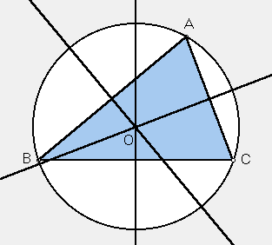
┴ Bisector Theorems (continued)
Since there are three sides in a ∆, then there are three ┴ Bisectors in a ∆.
These three ┴ bisectors in a ∆ intersect at a common point called the circumcenter.

Slide 9
Circumcenter Theorem
Theorem 5.4 (Circumcenter Theorem) The circumcenter of a ∆ is equidistant from the vertices of the ∆.
Notice, a circumcenter of a ∆ is the center of the circle we would draw if we connected all of the vertices with a circle on the outside (otherwise referred to as “to circumscribe” the ∆).
circumcenter

Slide 10
Example 1
EXAMPLE 1
Use the Perpendicular Bisector Theorem
ALGEBRA
BD is the perpendicular bisector of AC . Find AD.
AD = CD
Perpendicular Bisector Theorem
5x =
3x + 14
Substitute.
x =
7
Solve for x.
AD =
5x =
5(7) =
35.

Slide 11
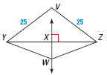
Example 2
EXAMPLE 2
Use perpendicular bisectors
In the diagram, WX is the perpendicular bisector of YZ .
a.
What segment lengths in the diagram are equal?
b.
Is V on WX ?
SOLUTION
a.
WX bisects YZ , so XY = XZ. Because W is on the perpendicular bisector of YZ, WY = WZ by Theorem 5.2. The diagram shows that VY = VZ = 25.
b.
Because VY = VZ, V is equidistant from Y and Z. So, by the Converse of the Perpendicular Bisector Theorem, V is on the perpendicular bisector of YZ , which is WX .

Slide 12
GUIDED PRACTICE
Example 3
In the diagram, JK is the perpendicular bisector of NL .
1.
What segment lengths are equal? Explain your reasoning.
ANSWER
NJ =LJ since JK bisects NL. NK = LK by the Perpendicular Bisector Theorem and the diagram shows ML = MN.

Slide 13
Example 4
GUIDED PRACTICE
In the diagram, JK is the perpendicular bisector of NL .
2.
Find NK.
ANSWER
13

Slide 14
Example 5
GUIDED PRACTICE
In the diagram, JK is the perpendicular bisector of NL .
3.
Explain why M is on JK .
ANSWER
Since ML = MN, M is equidistant from N and L, so by the Converse of the Perpendicular Bisector Theorem M is on the perpendicular bisector of NL which is JK.

Slide 15
KM is the perpendicular bisector of JL. Find JK and ML.
Example 6

Slide 16
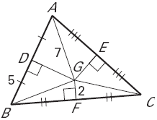
The perpendicular bisectors of ΔABC meet at point G. Find GB.
Example 7

Slide 17
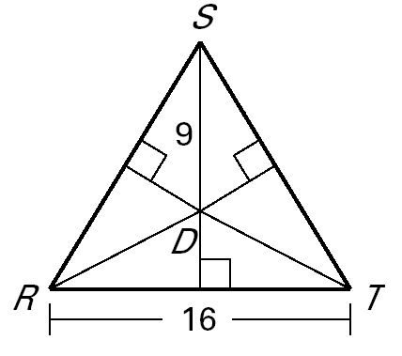
Example 8
The perpendicular bisectors of ΔRST meet at point D. Find DR and DU.

Slide 18
Circumcenter
Acute Triangle: Circumcenter is inside the triangle.
Right Triangle: Circumcenter is on the triangle.
Obtuse Triangle: Circumcenter is outside the triangle.
Additional Notes

