Slide 1
5.3 Use Angle Bisectors of Triangles

Slide 2
Objectives
Use properties of angle bisectors
Locate the incenter

Slide 3
Vocabulary
Recall, an angle bisector is a ray that divides an angle into two congruent adjacent angles.
The distance from a point to a line is the length of the perpendicular segment from the point to the line.
b

Slide 4
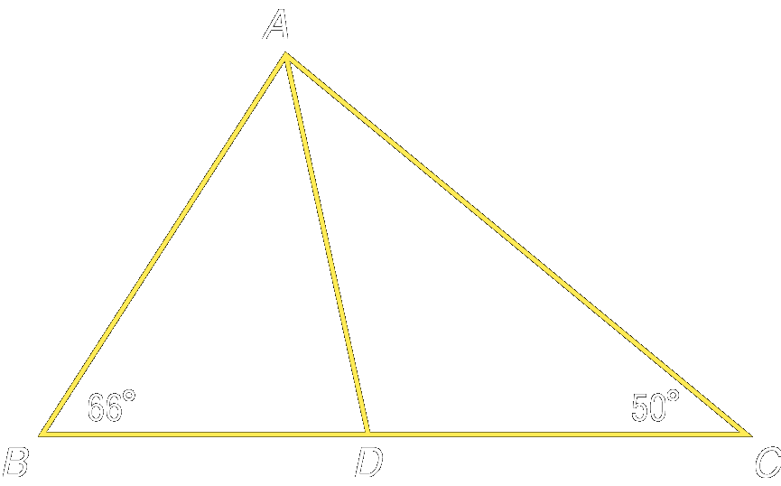
Angle Bisector Theorems
Theorem 5.5 - Angle Bisector Theorem:
If a point is on the bisector of an angle, then it is equidistant from the two sides of the angle. Since AD is an ∠ bisector, then DE ≅ DF.
Theorem 5.6 – Converse of the Angle Bisector Theorem:
If a point is in the interior of an angle and is equidistant from the sides of the angle, then it lies on the bisector of the angle.
E
F

Slide 5
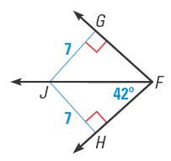
Example 1
EXAMPLE 1
Use the Angle Bisector Theorems
Find the measure of ∠GFJ.
SOLUTION
Because JG ⊥ FG and JH ⊥ FH and JG = JH = 7, FJ bisects ∠GFH by the Converse of the Angle Bisector Theorem. So, m∠GFJ = m∠HFJ = 42°.

Slide 6
Example 2
EXAMPLE 2
A soccer goalkeeper’s position relative to the ball and goalposts forms congruent angles, as shown. Will the goalie have to move farther to block a shot toward the right goalpost R or the left goalpost L?
SOLUTION
The congruent angles tell you that the goalie is on the bisector of ∠ LBR. By the Angle Bisector Theorem, the goalie is equidistant from BR and BL .
So, the goalie must move the same distance to block either shot.

Slide 7
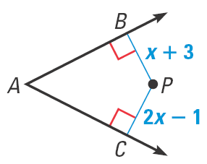
Example 3
EXAMPLE 3
Use algebra to solve a problem
For what value of x does P lie on the bisector of ∠ A?
SOLUTION
From the Converse of the Angle Bisector Theorem, you know that if P lies on the bisector of ∠A then P is equidistant from the sides of ∠A, so BP = CP.
BP =
CP
Set segment lengths equal.
x + 3 =
2x –1
Substitute expressions for segment lengths.
4 =
x
Solve for x.
Point P lies on the bisector of ∠ A when x = 4.

Slide 8
More Practice Problems
GUIDED PRACTICE
For numbers1–3, find the value of x.
1.
2.
B
B
P
P
A
A
C
C
ANSWER
15
ANSWER
11
3.
P
ANSWER
5
B
C
A

Slide 9
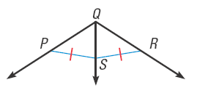
Example 4
GUIDED PRACTICE
Do you have enough information to conclude that
QS bisects ∠ PQR? Explain.
ANSWER
No; you need to establish that SR ⊥ QR and SP ⊥ QP.

Slide 10
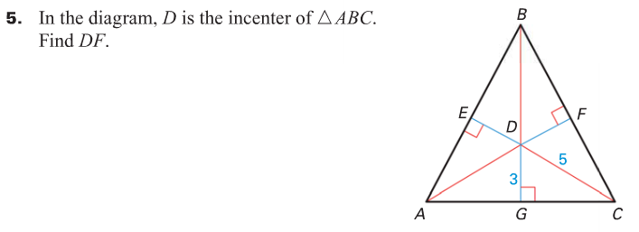
Theorem 5.7 Concurrency of Angle Bisectors of a Triangle:
The angle bisectors of a triangle intersect at a point that is equidistant from the sides of the triangle.
The point of concurrency of the three angle bisectors of a triangle is called the incenter of the triangle.
The incenter always lies inside the triangle.
Vocabulary and Another Theorem

Slide 11
Example 5
EXAMPLE 4
Use the concurrency of angle bisectors
In the diagram, N is the incenter of ΔABC. Find ND.
SOLUTION
By the Concurrency of Angle Bisectors of a Triangle Theorem, the incenter N is equidistant from the sides of Δ ABC. So, to find ND, you can find NF in Δ AF. Use the Pythagorean Theorem, a² + b² = c².

Slide 12
Example 5 (continued):
EXAMPLE 4
2
2
2
c =
a + b
Pythagorean Theorem
2
2
2
20 =
NF + 16
Substitute known values.
400 =
2
NF + 256
Multiply.
144 =
2
NF
Subtract 256 from each side.
12 =
NF
Take the positive square root of each side.
Because NF = ND, ND = 12.

