Slide 1
7.3 Similar Triangles

Slide 2
Objectives
Identify similar triangles
Use similar triangles to solve problems

Slide 3
Similar Triangles
Previously, we learned how to determine if two triangles were congruent (SSS, SAS, ASA, AAS). There are also several tests to prove triangles are similar.
Postulate 6.1 – AA Similarity 2 ∠s of a Δ are ≅ to 2 ∠s of another Δ
Theorem 6.1 – SSS Similarity corresponding sides of 2 Δs are proportional
Theorem 6.2 – SAS Similarity corresponding sides of 2 Δs are proportional and the included ∠s are ≅

Slide 4
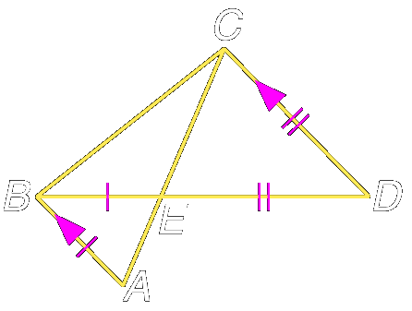
Example 1:
In the figure, and Determine which triangles in the figure are similar.

Slide 5
Example 1:
by the Alternate Interior Angles Theorem.
Vertical angles are congruent,
Answer: Therefore, by the AA Similarity Theorem,

Slide 6
Your Turn:
In the figure, OW = 7, BW = 9, WT = 17.5, and WI = 22.5. Determine which triangles in the figure are similar and why.
I
Answer:

Slide 7
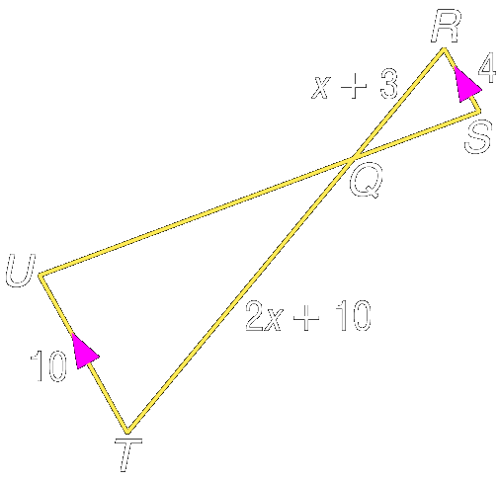
Example 2:
ALGEBRA Given QT 2x 10, UT 10, find RQ and QT.

Slide 8
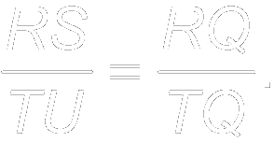
Example 2:
Since because they are alternate interior angles. By AA Similarity, Using the definition of similar polygons,
Substitution
Cross products

Slide 9
Example 2:
Distributive Property
Subtract 8x and 30 from each side.
Divide each side by 2.
Now find RQ and QT.
Answer:

Slide 10
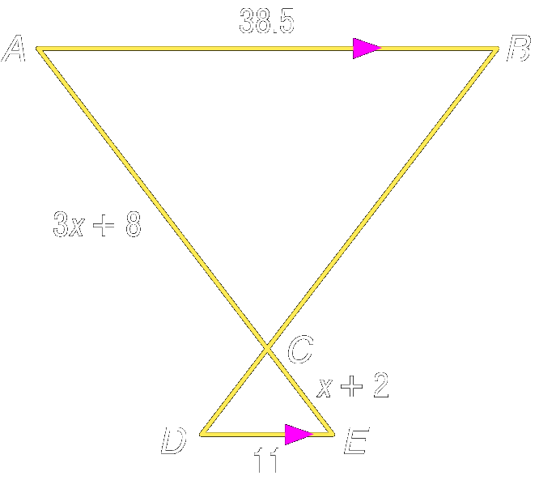
Your Turn:
ALGEBRA Given and CE x + 2, find AC and CE.
Answer:

Slide 11
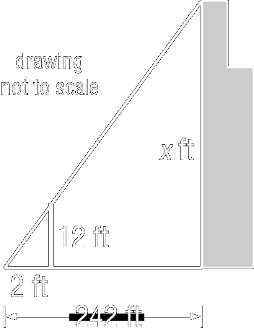
Example 3:
INDIRECT MEASUREMENT Josh wanted to measure the height of the Sears Tower in Chicago. He used a 12-foot light pole and measured its shadow at 1 P.M. The length of the shadow was 2 feet. Then he measured the length of the Sears Tower’s shadow and it was 242 feet at that time. What is the height of the Sears Tower?

Slide 12
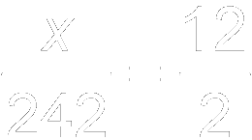
Example 3:
Assuming that the sun’s rays form similar triangles, the following proportion can be written.
Now substitute the known values and let x be the height of the Sears Tower.
Substitution
Cross products

Slide 13
Example 3:
Simplify.
Divide each side by 2.
Answer: The Sears Tower is 1452 feet tall.

Slide 14
Assignment
Geometry Pg. 302 # 10 – 20, 24, 25, 26, 28
Pre-AP Geometry Pg. 302 #10 – 28, 30, 32

