Slide 1
7.4 Parallel Lines and Proportional Parts

Slide 2
Objectives
Use proportional parts of triangles
Divide a segment into parts

Slide 3
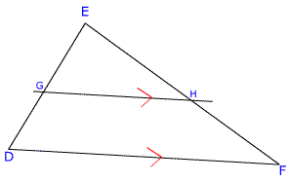
Triangle Proportionality Theorem
If a line is parallel to one side of a Δ and intersects the other two sides in two distinct points, then it separates these sides into segments of proportional lengths.
EG = EH GD HF
*The Converse of the Δ Proportionality Theorem is also true.

Slide 4
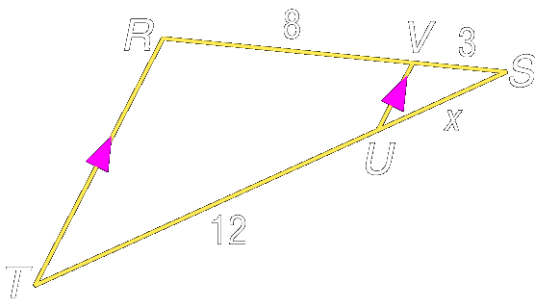
Example 1:
In and Find SU.
S
From the Triangle Proportionality Theorem,

Slide 5
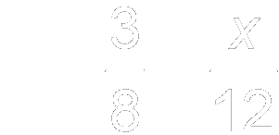
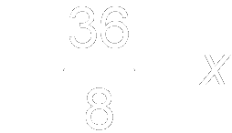
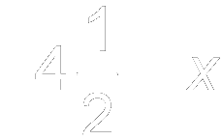
Example 1:
Substitute the known measures.
Cross products
Multiply.
Divide each side by 8.
Simplify.
Answer:

Slide 6
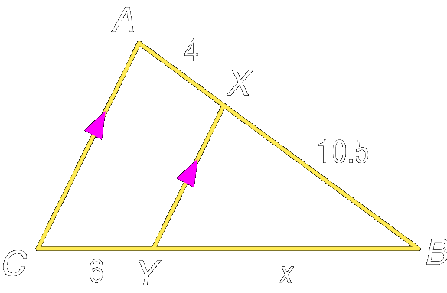
Your Turn:
In and Find BY.
B
Answer: 15.75

Slide 7
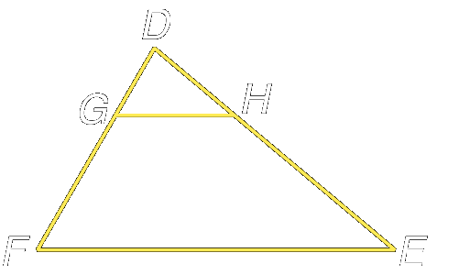
Example 2:
In and Determine whether Explain.

Slide 8
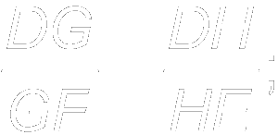
Example 2:
In order to show that we must show that
Since the sides have proportional length.
Answer: since the segments have proportional lengths,

Slide 9
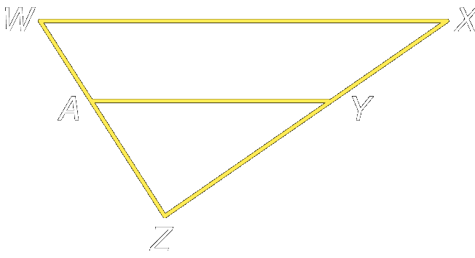
Your Turn:
In and AZ = 32. Determine whether Explain.
X
Answer: No; the segments are not in proportion since

Slide 10
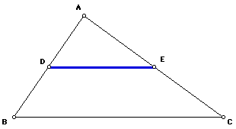
Triangle Midsegment Theorem
A midsegment is a segment whose endpoints are the midpoints of two sides of a Δ.
A midsegment of a triangle is parallel to one side of the triangle, and its length is ½ the length of the side its parallel to.
If D and E are midpoints of AB and AC respectively and DE || BC then DE = ½ BC.

Slide 11
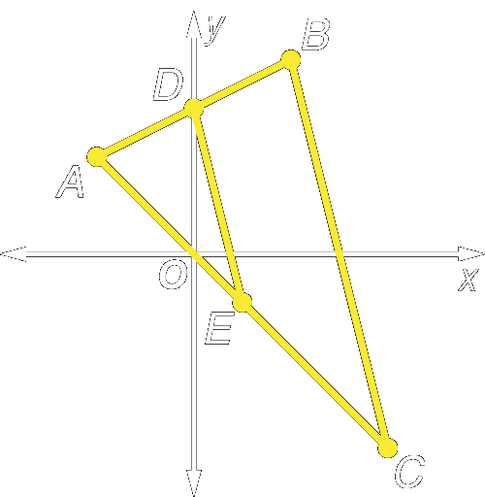
Example 3a:
Triangle ABC has vertices A(–2, 2), B(2, 4,) and C(4, –4). is a midsegment of Find the coordinates of D and E.
(2, 4)
(-2, 2)
(4, –4)

Slide 12
Example 3a:
Use the Midpoint Formula to find the midpoints of
Answer: D(0, 3), E(1, –1)

Slide 13
Example 3b:
Triangle ABC has vertices A(–2, 2), B(2, 4) and C(4, –4). is a midsegment of Verify that
(2, 4)
(-2, 2)
(4, –4)

Slide 14
Example 3b:
If the slopes of
slope of
slope of
Answer: Because the slopes of

Slide 15
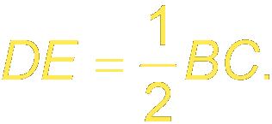
Example 3c:
Triangle ABC has vertices A(–2, 2), B(2, 4) and C(4, –4). is a midsegment of Verify that
(2, 4)
(-2, 2)
(4, –4)

Slide 16
Example 3c:
First, use the Distance Formula to find BC and DE.

Slide 17
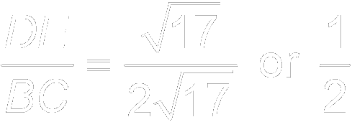
Example 3c:
Answer:

Slide 18
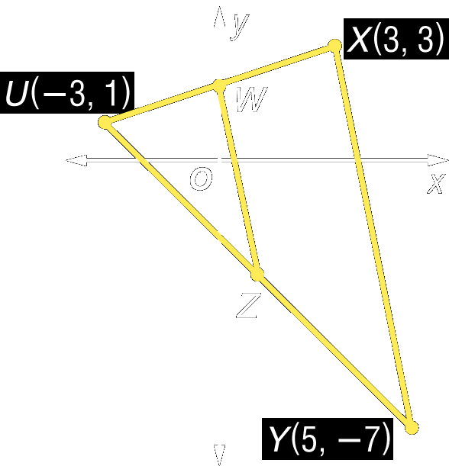
Your Turn:
Triangle UXY has vertices U(–3, 1), X(3, 3), and Y(5, –7). is a midsegment of

Slide 19
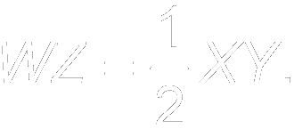
Your Turn:
a. Find the coordinates of W and Z.
b. Verify that
c. Verify that
Answer: W(0, 2), Z(1, –3)
Answer: Since the slope of and the slope of
Answer: Therefore,

Slide 20
Divide Segments Proportionally
The Δ Proportionality Theorem has shown us that || lines cut the sides of a Δ into proportional parts. Three or more parallel lines also separate transversals into proportional parts.

Slide 21
Divide Segments Proportionally
Corollary 6.1 If 3 or more || lines intersect 2 transversals, then they cut off the transversals proportionally.

Slide 22
Divide Segments Proportionally
Corollary 6.2 If 3 or more || lines cut off ≅ segments on 1 transversal, then they cut off ≅ segments on every transversal.

Slide 23
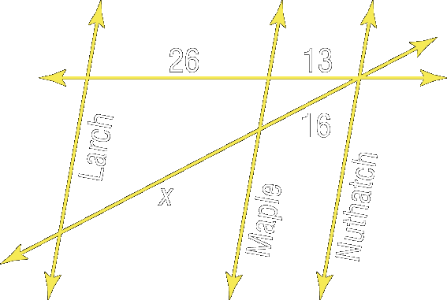
Example 4:
In the figure, Larch, Maple, and Nuthatch Streets are all parallel. The figure shows the distances in city blocks that the streets are apart. Find x.

Slide 24
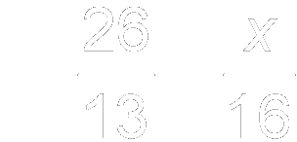
Example 4:
Notice that the streets form a triangle that is cut by parallel lines. So you can use the Triangle Proportionality Theorem.
Triangle Proportionality Theorem
Cross products
Multiply.
Divide each side by 13.
Answer: 32

Slide 25
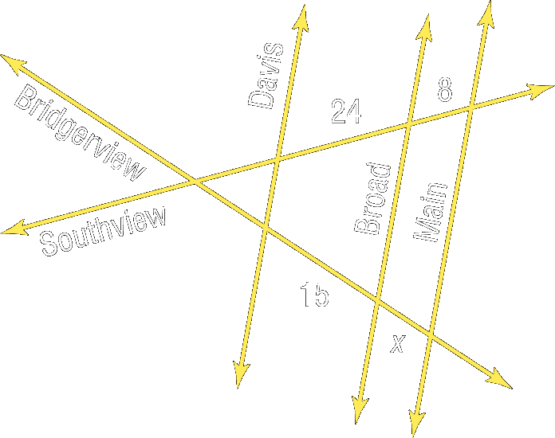
Your Turn:
In the figure, Davis, Broad, and Main Streets are all parallel. The figure shows the distances in city blocks that the streets are apart. Find x.
Answer: 5

Slide 26
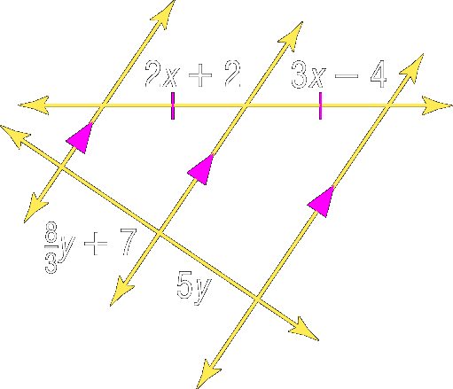
Example 5:
Find x and y.
To find x:
Given
Subtract 2x from each side.
Add 4 to each side.

Slide 27
Example 5:
To find y:
The segments with lengths are congruent since parallel lines that cut off congruent segments on one transversal cut off congruent segments on every transversal.

Slide 28
Example 5:
Equal lengths
Multiply each side by 3 to eliminate the denominator.
Subtract 8y from each side.
Divide each side by 7.
Answer: x = 6; y = 3

Slide 29
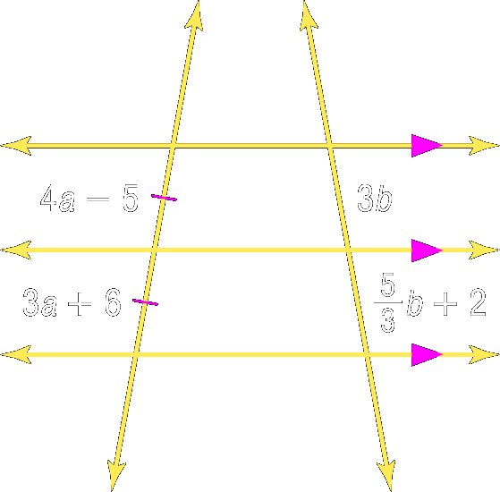
Your Turn:
Find a and b.
Answer: a = 11; b = 1.5

Slide 30
Assignment
Geometry Pg. 312 #14 – 26, 33 and 34
Pre-AP Geometry Pg. 312 #14 – 30, 33 and 34

