Slide 1
7.5 Parts of Similar Triangles

Slide 2
Objectives
Recognize and use proportional relationships of corresponding perimeters of similar triangles
Recognize and use proportional relationships of corresponding angle bisectors, altitudes, and medians of similar triangles

Slide 3
Proportional Perimeters Theorem
If two Δs are similar, then the perimeters are proportional to the measures of the corresponding sides.

Slide 4
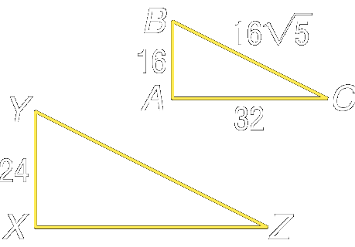
Example 1:
If and find the perimeter of
C
Let x represent the perimeter of The perimeter of

Slide 5
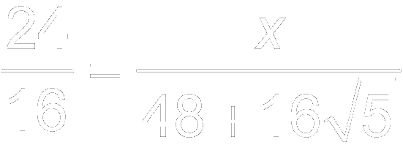
Example 1:
Proportional Perimeter Theorem
Substitution
Cross products
Multiply.
Divide each side by 16.
Answer: The perimeter of

Slide 6
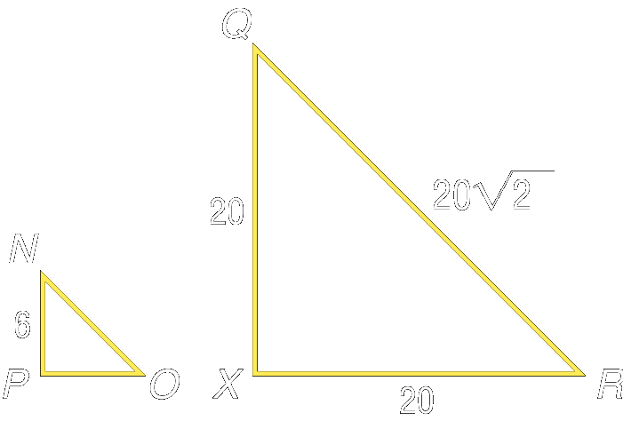
Your Turn:
If and RX = 20, find the perimeter of
R
Answer:

Slide 7
Special Segments of ~ Δs
Theorem 6.8 In ~ Δs, corresponding altitudes are proportional to the measures of the corresponding sides
Theorem 6.9 In ~ Δs, corresponding angle bisectors are proportional to the measures of the corresponding sides
Theorem 6.10 In~ Δs, corresponding medians are proportional to the measures of the corresponding sides

Slide 8
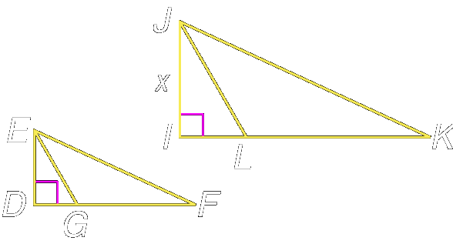
Example 2:
In the figure, is an altitude of and is an altitude of Find x if and
K

Slide 9
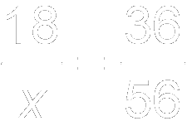
Example 2:
Write a proportion.
Cross products
Divide each side by 36.
Answer: Thus, JI = 28.

Slide 10
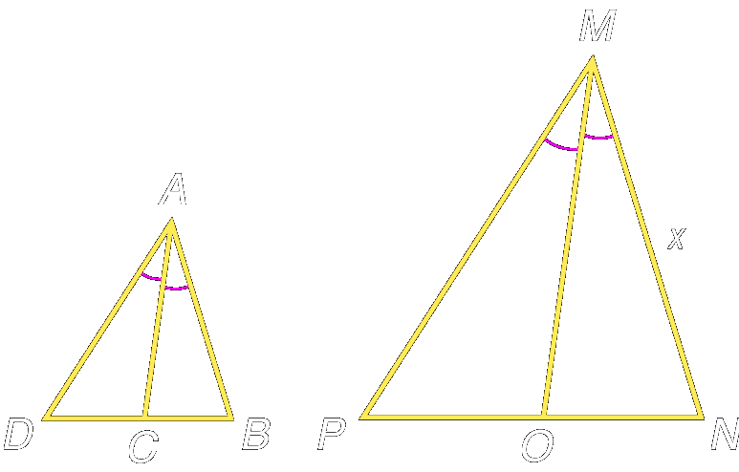
Your Turn:
In the figure, is an angle bisector of and is an angle bisector of Find x if
N
Answer: 17.5

Slide 11
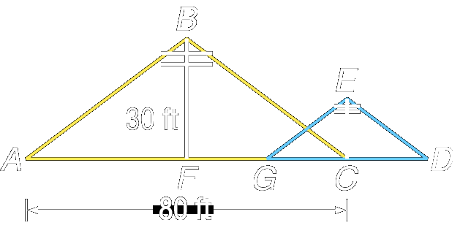
Example 3:
The drawing below illustrates two poles supported by wires. , , and Find the height of the pole .

Slide 12
Example 3:
are medians of since and If two triangles are similar, then the measures of the corresponding medians are proportional to the measures of the corresponding sides. This leads to the
proportion
measures 40 ft. Also, since both measure 20 ft. Therefore,

Slide 13
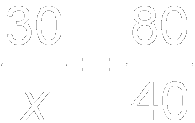
Example 3:
Write a proportion.
Cross products
Simplify.
Divide each side by 80.
Answer: The height of the pole is 15 feet.

Slide 14
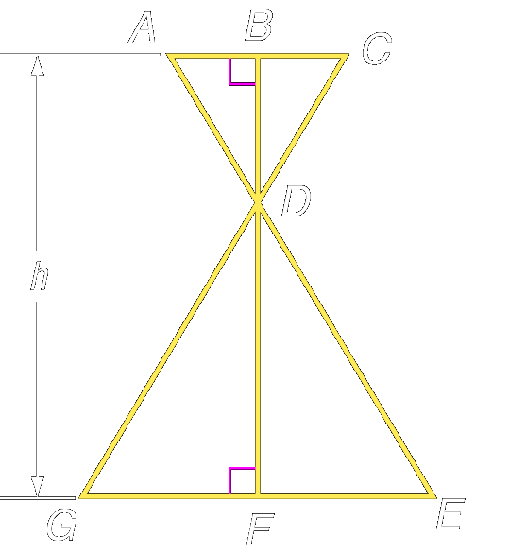
Your Turn:
The drawing below illustrates the legs, of a table. The top of the legs are fastened so that AC measures 12 inches while the bottom of the legs open such that GE measures 36 inches. If BD measures 7 inches, what is the height h of the table?
Answer: 28 in.

Slide 15
Assignment
Geometry Pg. 320 #10 – 24
Pre-AP Geometry Pg. 320 #10 – 28

